Slide 2
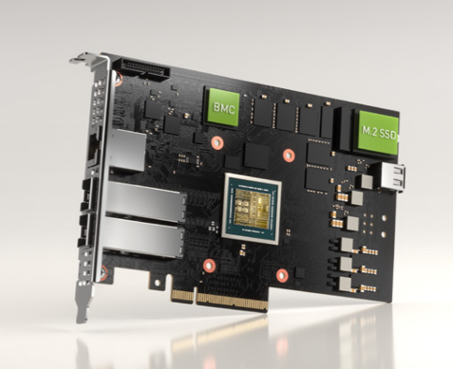
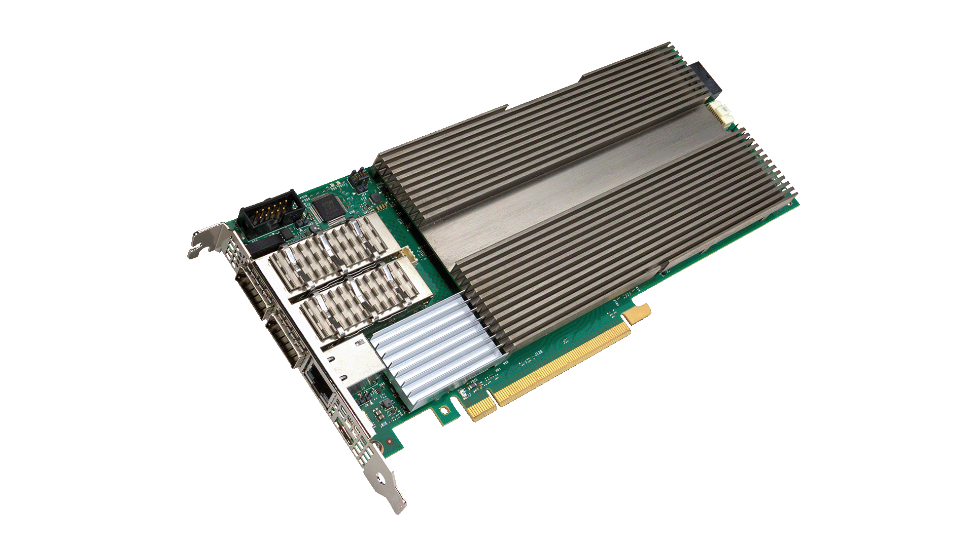
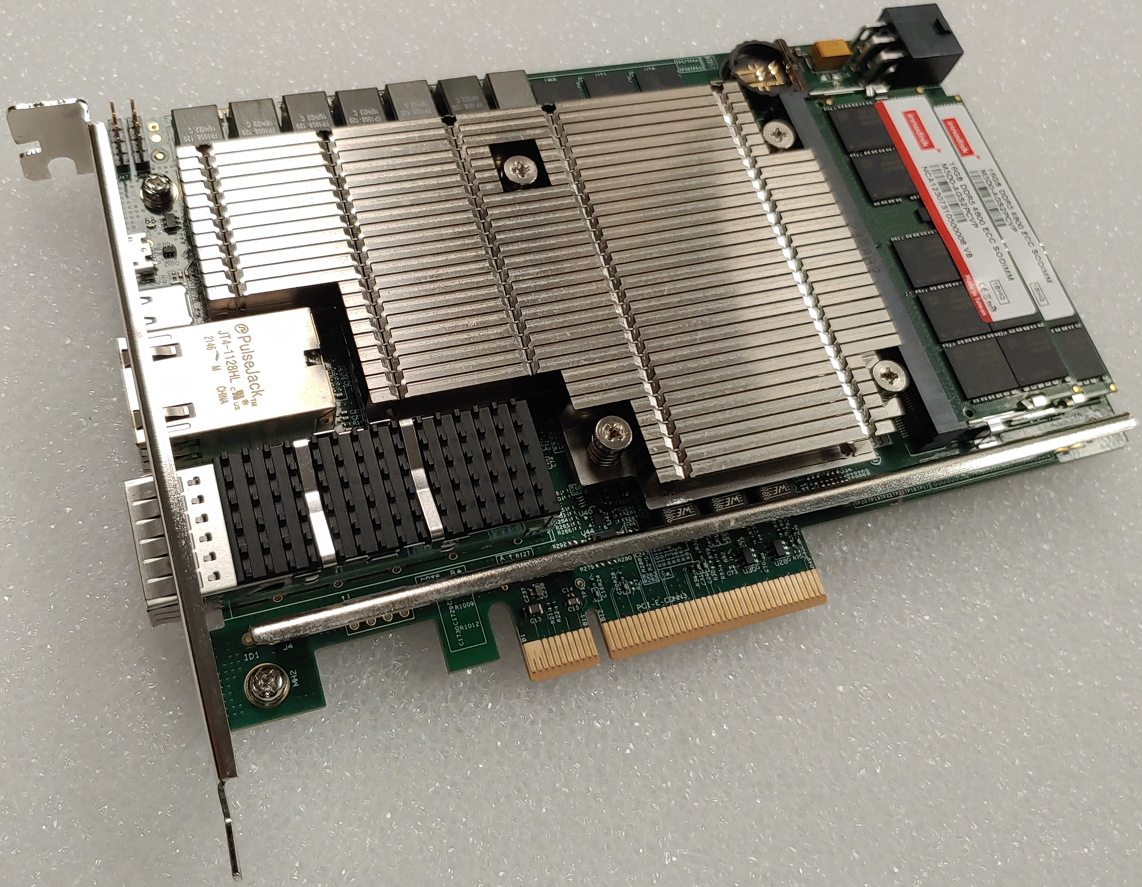
OPI's vendor agnostic API-driven configuration
Nvidia BlueField2/3
Intel Dayton Peak
Marvell CN106

Slide 3
Nvidia DPU IPsec Demo
Nvidia BlueField2/3
Demo Highlights:
Nvidia DPU Blue Field 3 terminating IPsec tunnel
IPsec configuration using OPI’s vendor-agnostic API
Validating end to end IPsec using Keysight CyPerf

Slide 4
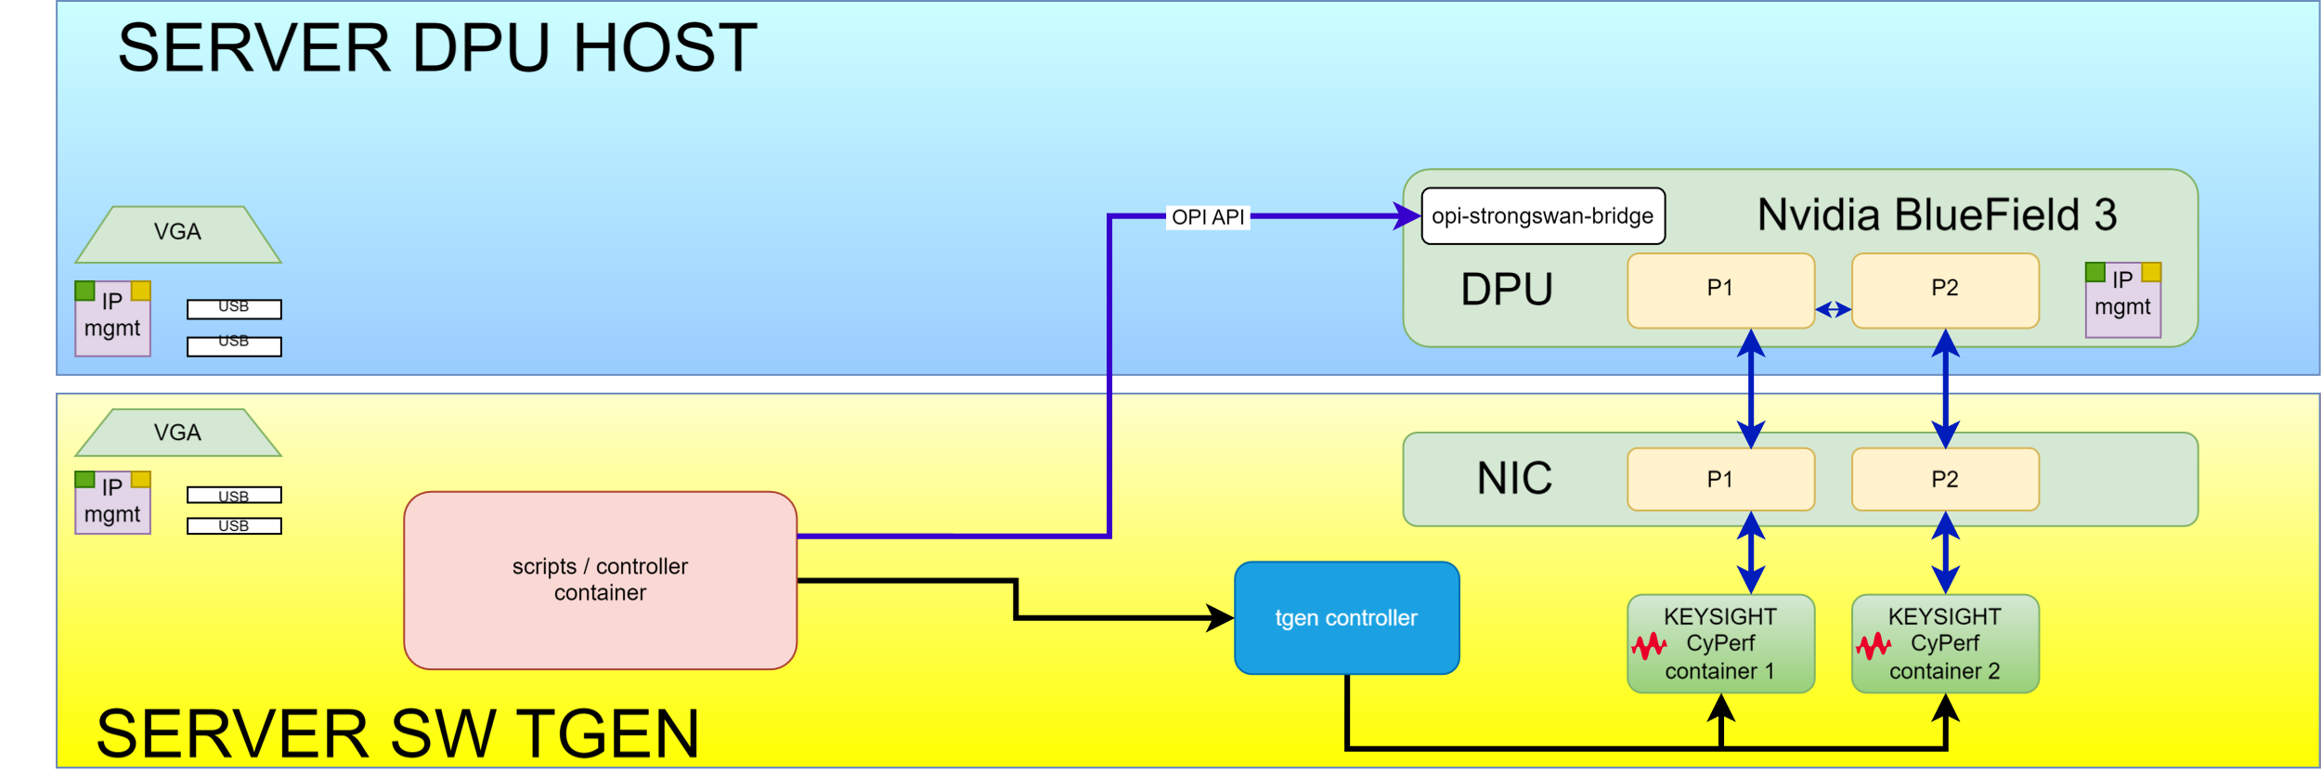
Testbed Topology
https://github.com/opiproject/opi-poc/tree/main/lab

Slide 5
